Slide 1
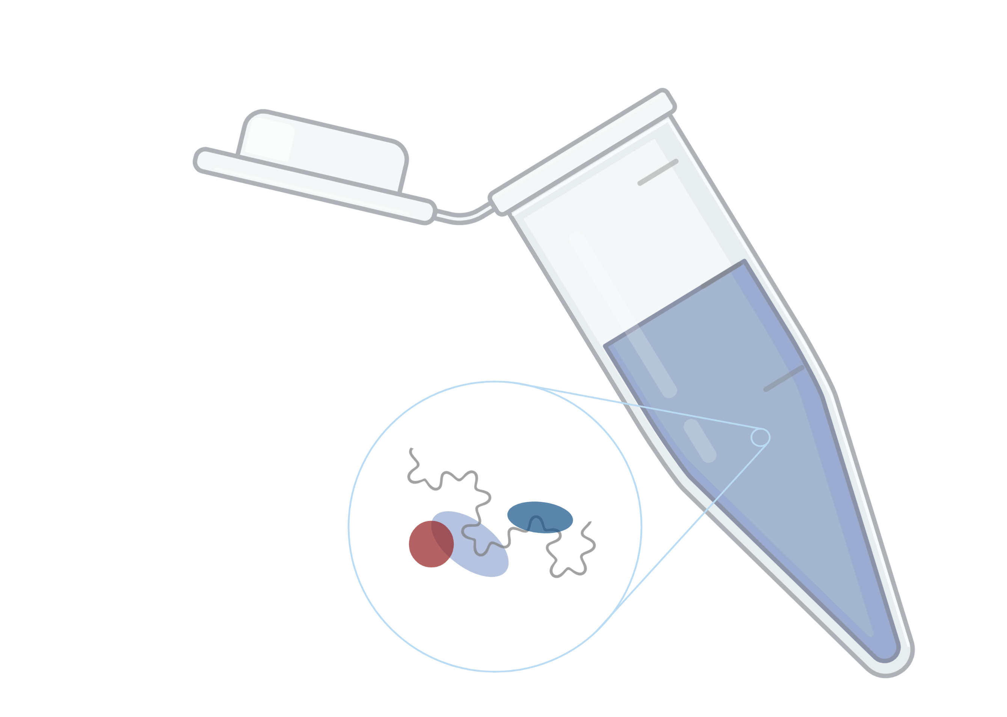
Proteome-wide Screen for RNA-dependent Proteins in HeLa cells
Project Proposal
Data Analysis Project 2022
Group 5: Katharina Lotter, Laura Herrfurth, Marie Lulu Salein, Kiren A. Nadeem
Supervisors: Dr. Maïwen Caudron-Herger, Niklas Engel
Molecular Biotechnology B.Sc. Ruprecht Karls University of Heidelberg
Created with BioRender.com

Slide 2

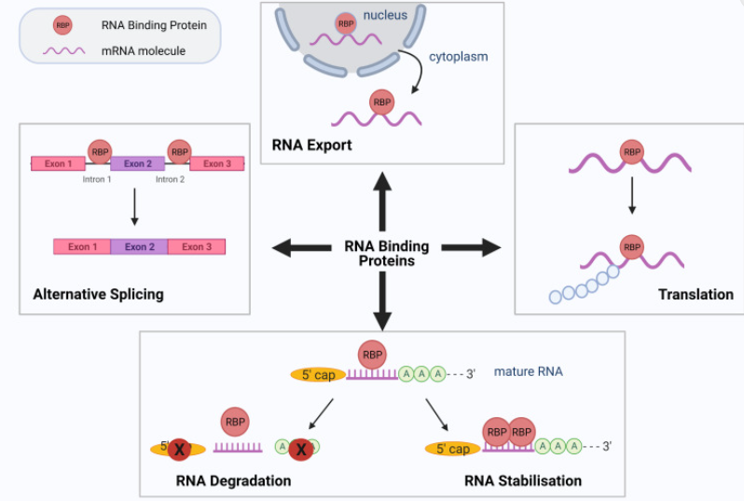
Why should we care? - The role of RBPs
RNA is essential for gene expression
RBPs regulate splicing & post translational modification
RNA is more than just a template!
Role of non coding RNA is still not completely understood
RNA is not alone
During every step of RNA metabolism RBPs are associated with RNA
Cooperative & antagonistic interactions
Dynamic associations
→fine-tuned regulation of their RNA targets

Slide 3

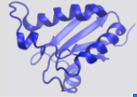
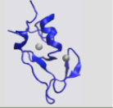
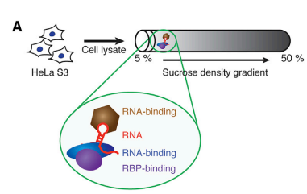
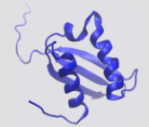
RBPs
Definition
RNA binding
RNA dependent (interactome depends on RNA)
Interaction
Dynamic
Cooperative & antagonistic
Specificity
RBPs can also have multiple RNA targets
Heterogenous binding domains
Diverse class of proteins (can we predict RNA binding by looking at other traits?)
RNA recognition motif
Zinc finger binding domain
K Homology
Notes:
RNA recognition motiv
90 amino acids

Slide 4
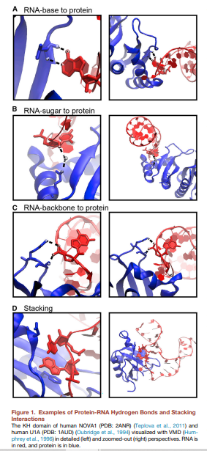
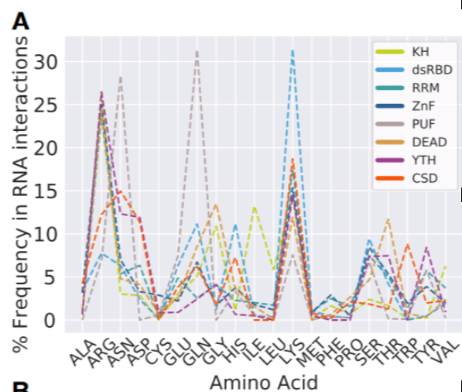
RBPs - Interaction with RNA
Hydrogen bonds and stacking interactions
Amino acid preferences of RBPs
Notes:
Amino acid preferences:
Regression analysis: can we predict if a protein is RNA dependent by looking at ist domains and its amino acid preferences
- How many other traits (e.g. the isoelectric point) do we have to include to make accurate predictions?

Slide 5

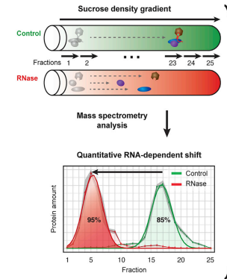
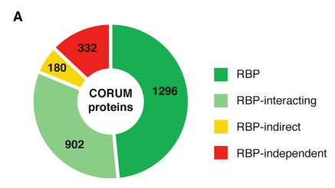
Sucrose Density Gradient Method - identification of new RBPs and RNA dependent proteins
If the protein is RNA dependent it will dissociate and migrate to a different fraction
Left shift: loss of interaction partners
Right shift: gain of interaction partners
Information on the quantitiy of the fraction that is associated with RNA
→ strategy to gain insight on RNA function by protein analysis
Notes:
Why is it important to know more about RBPs → severe diseases when malfunctioning

Slide 6

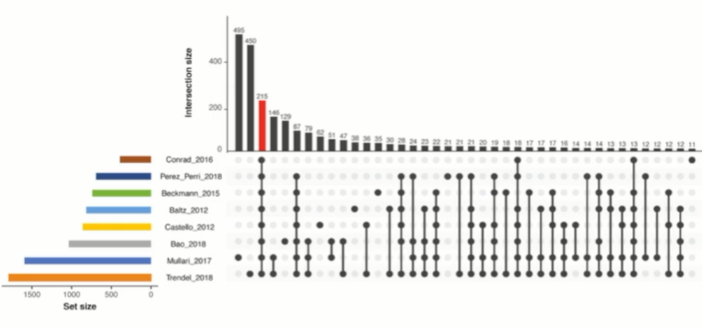
Why is that important? - Study gap on RBPs Anmerkung: ich glaube die Abbildung ist aus ihrem Video, finden wir die auch in ein bisschen schärfer?
Notes:
Only 215 common proteins so far
High need for proteome wide studies dedicated to the identification of RBPs

Slide 7
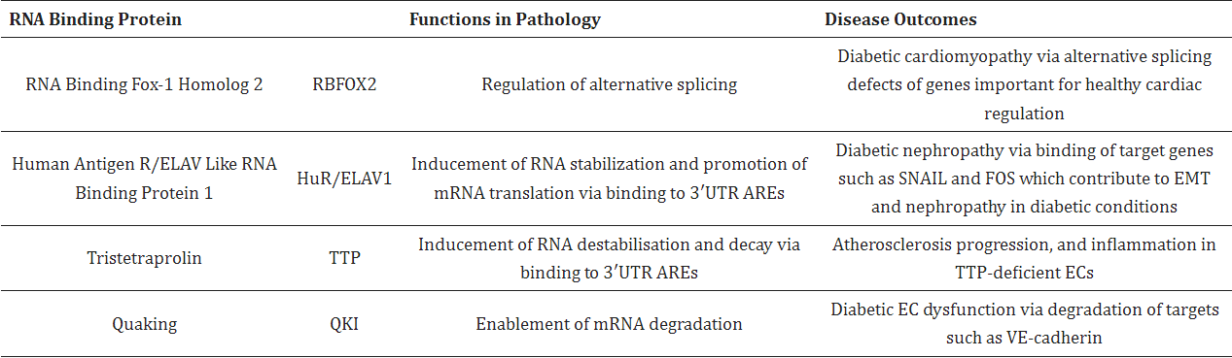
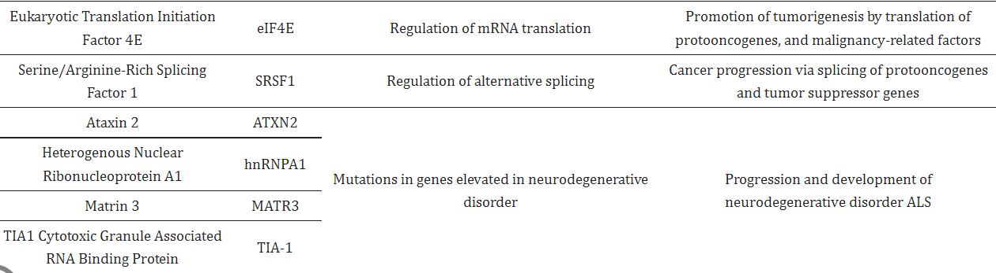
RBPs and diseases
Notes:
Malfunction of RBPs results in severe diseases
Alternative splicing defects, RNA destabilization, stabilization of proto-onkogenes, alternative polyadenylation
Chronic inflammation and autoimmune diseases (involved in regulating the pro-inflammatory cytokines IL6 and TNF alpha)
Potential for cancer: targeting RBPs coupled with immunotherapy
Diabetic cardiomyopathy & nepropathy
Artherosclerosis progression

Slide 8
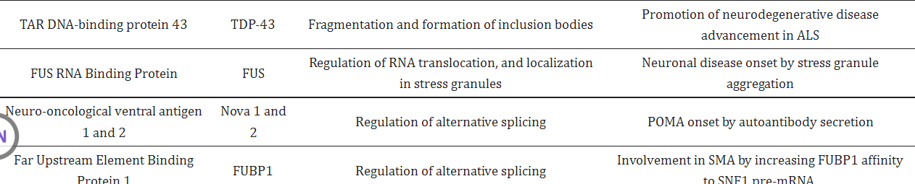
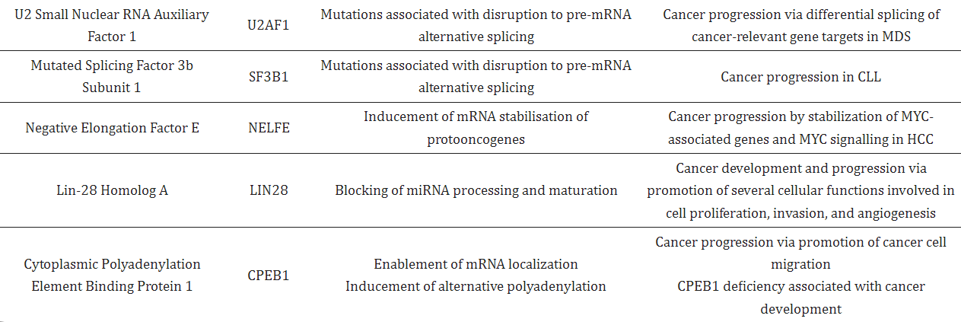
Notes:
Not just severe consequences in cancer but also in neurodegenerative dieseases such as ALS
Fragmentation and formation of inclusion bodies
Important in embyronic development
Somatic tissue development: RBPs can have multiple target RNAs
Dendritogenesis in hippocampal neurons

Slide 9
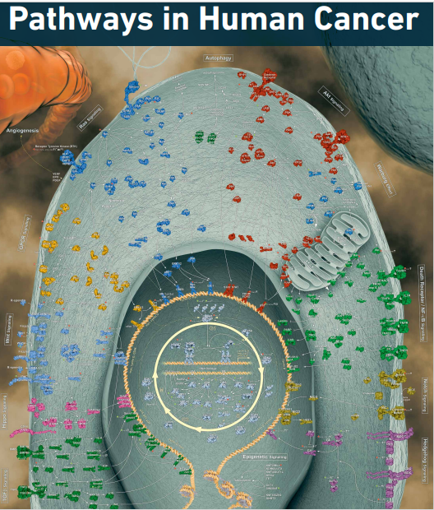
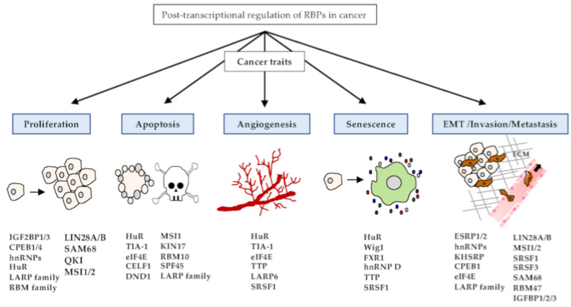
RBPs in cancer
Notes:
Knowledge on the understanding of cellular pathways (esp their dysfunction in cancer)
- RBPs are important for the promotion of cell proliferation, cell migration and angiogenesis
Function of non-coding RNAs
New therapeutic targets
So far research focus has mostly been on genomics
Focusing on transciptiomics might introduce medicine to a whole new area of cancer therapeutics

Slide 10
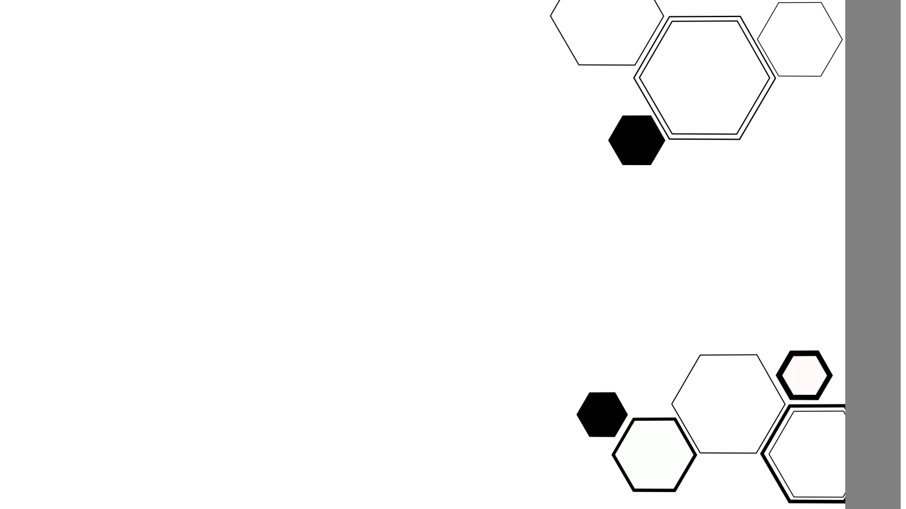
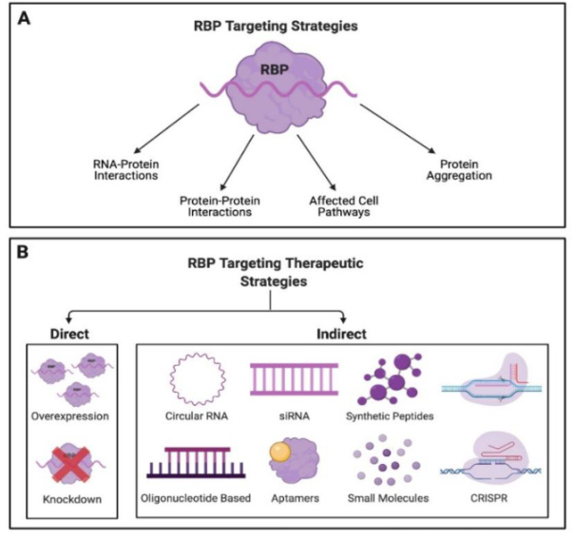
Why should everyone else care? - translational potential of RBP research

Slide 11
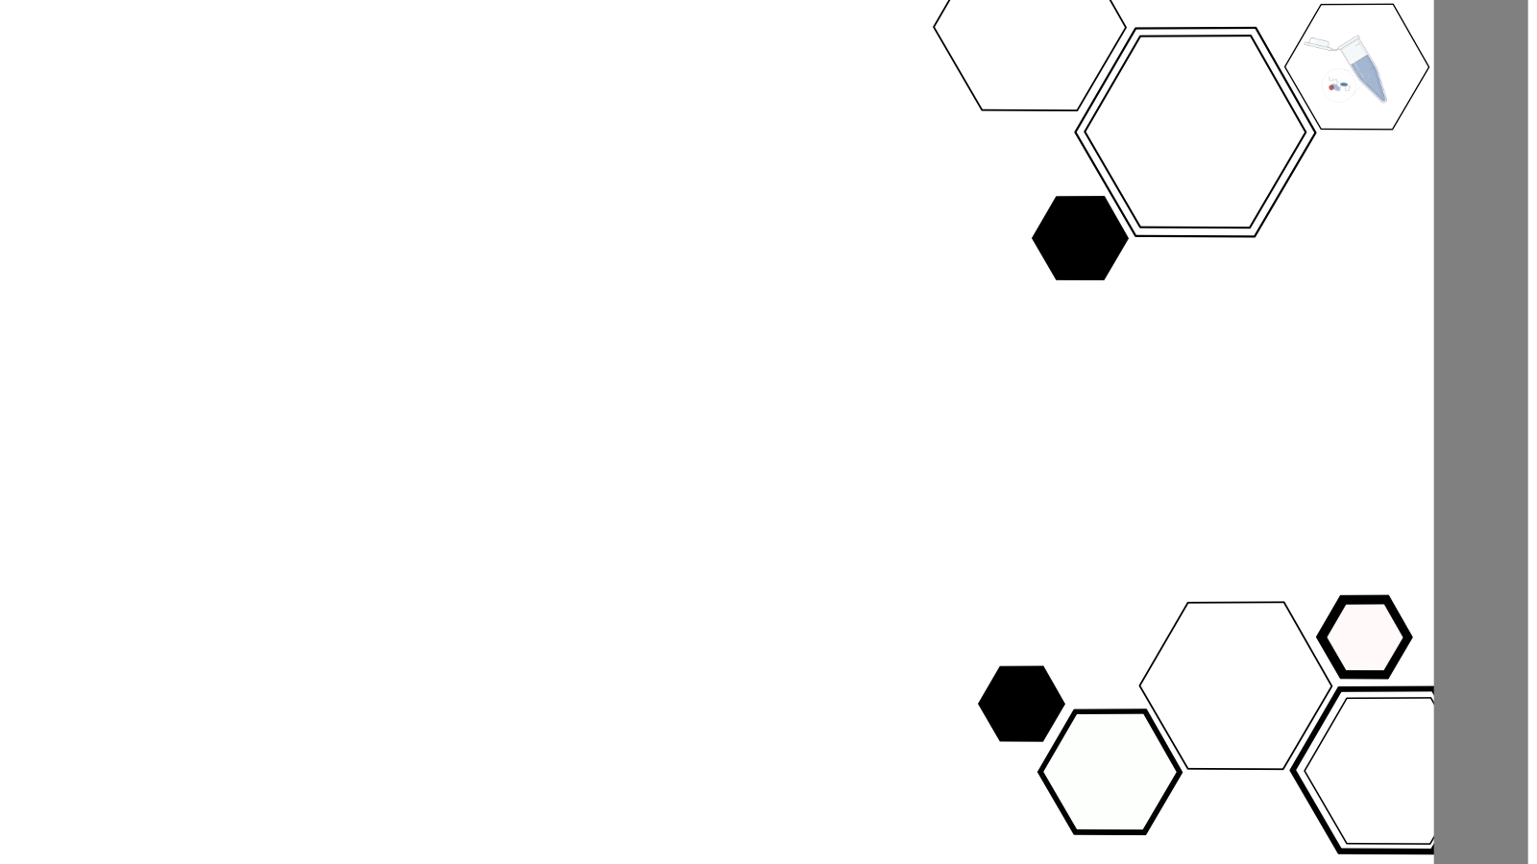
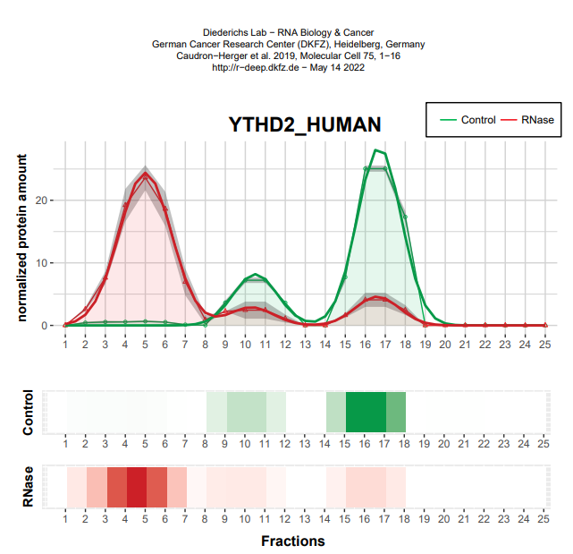
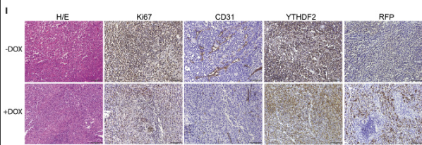
Example of RBP therapeutics: YTDF2
RBP highly expressed in tumor cells
Depletion of YTHDF2 induces apoptosis in human triple-negative breast cancer cell lines
Impended xenograft tumor in vivo (mouse model) YTDF2 contributes to the EMT transition
Mice with YTDF2 knockout had less tumor cells
Immunohistochemistry staining:
Depletion of YTHDF2 in TNBC cells suppresses tumor growth in vivo
Notes:
DOX: doxycycline inducible shRNAs, that target seveeral proteins mediating RNA stability
YTHDF2 hairpin was depleted in tumor cells which caused a growth disadvantage
Understanding RBPs will create discoveries with a high translational potential
Introduce us to new therapeutic targets
And in the end will advance research and development of therapies in areas with a high unmet medical need

Slide 12
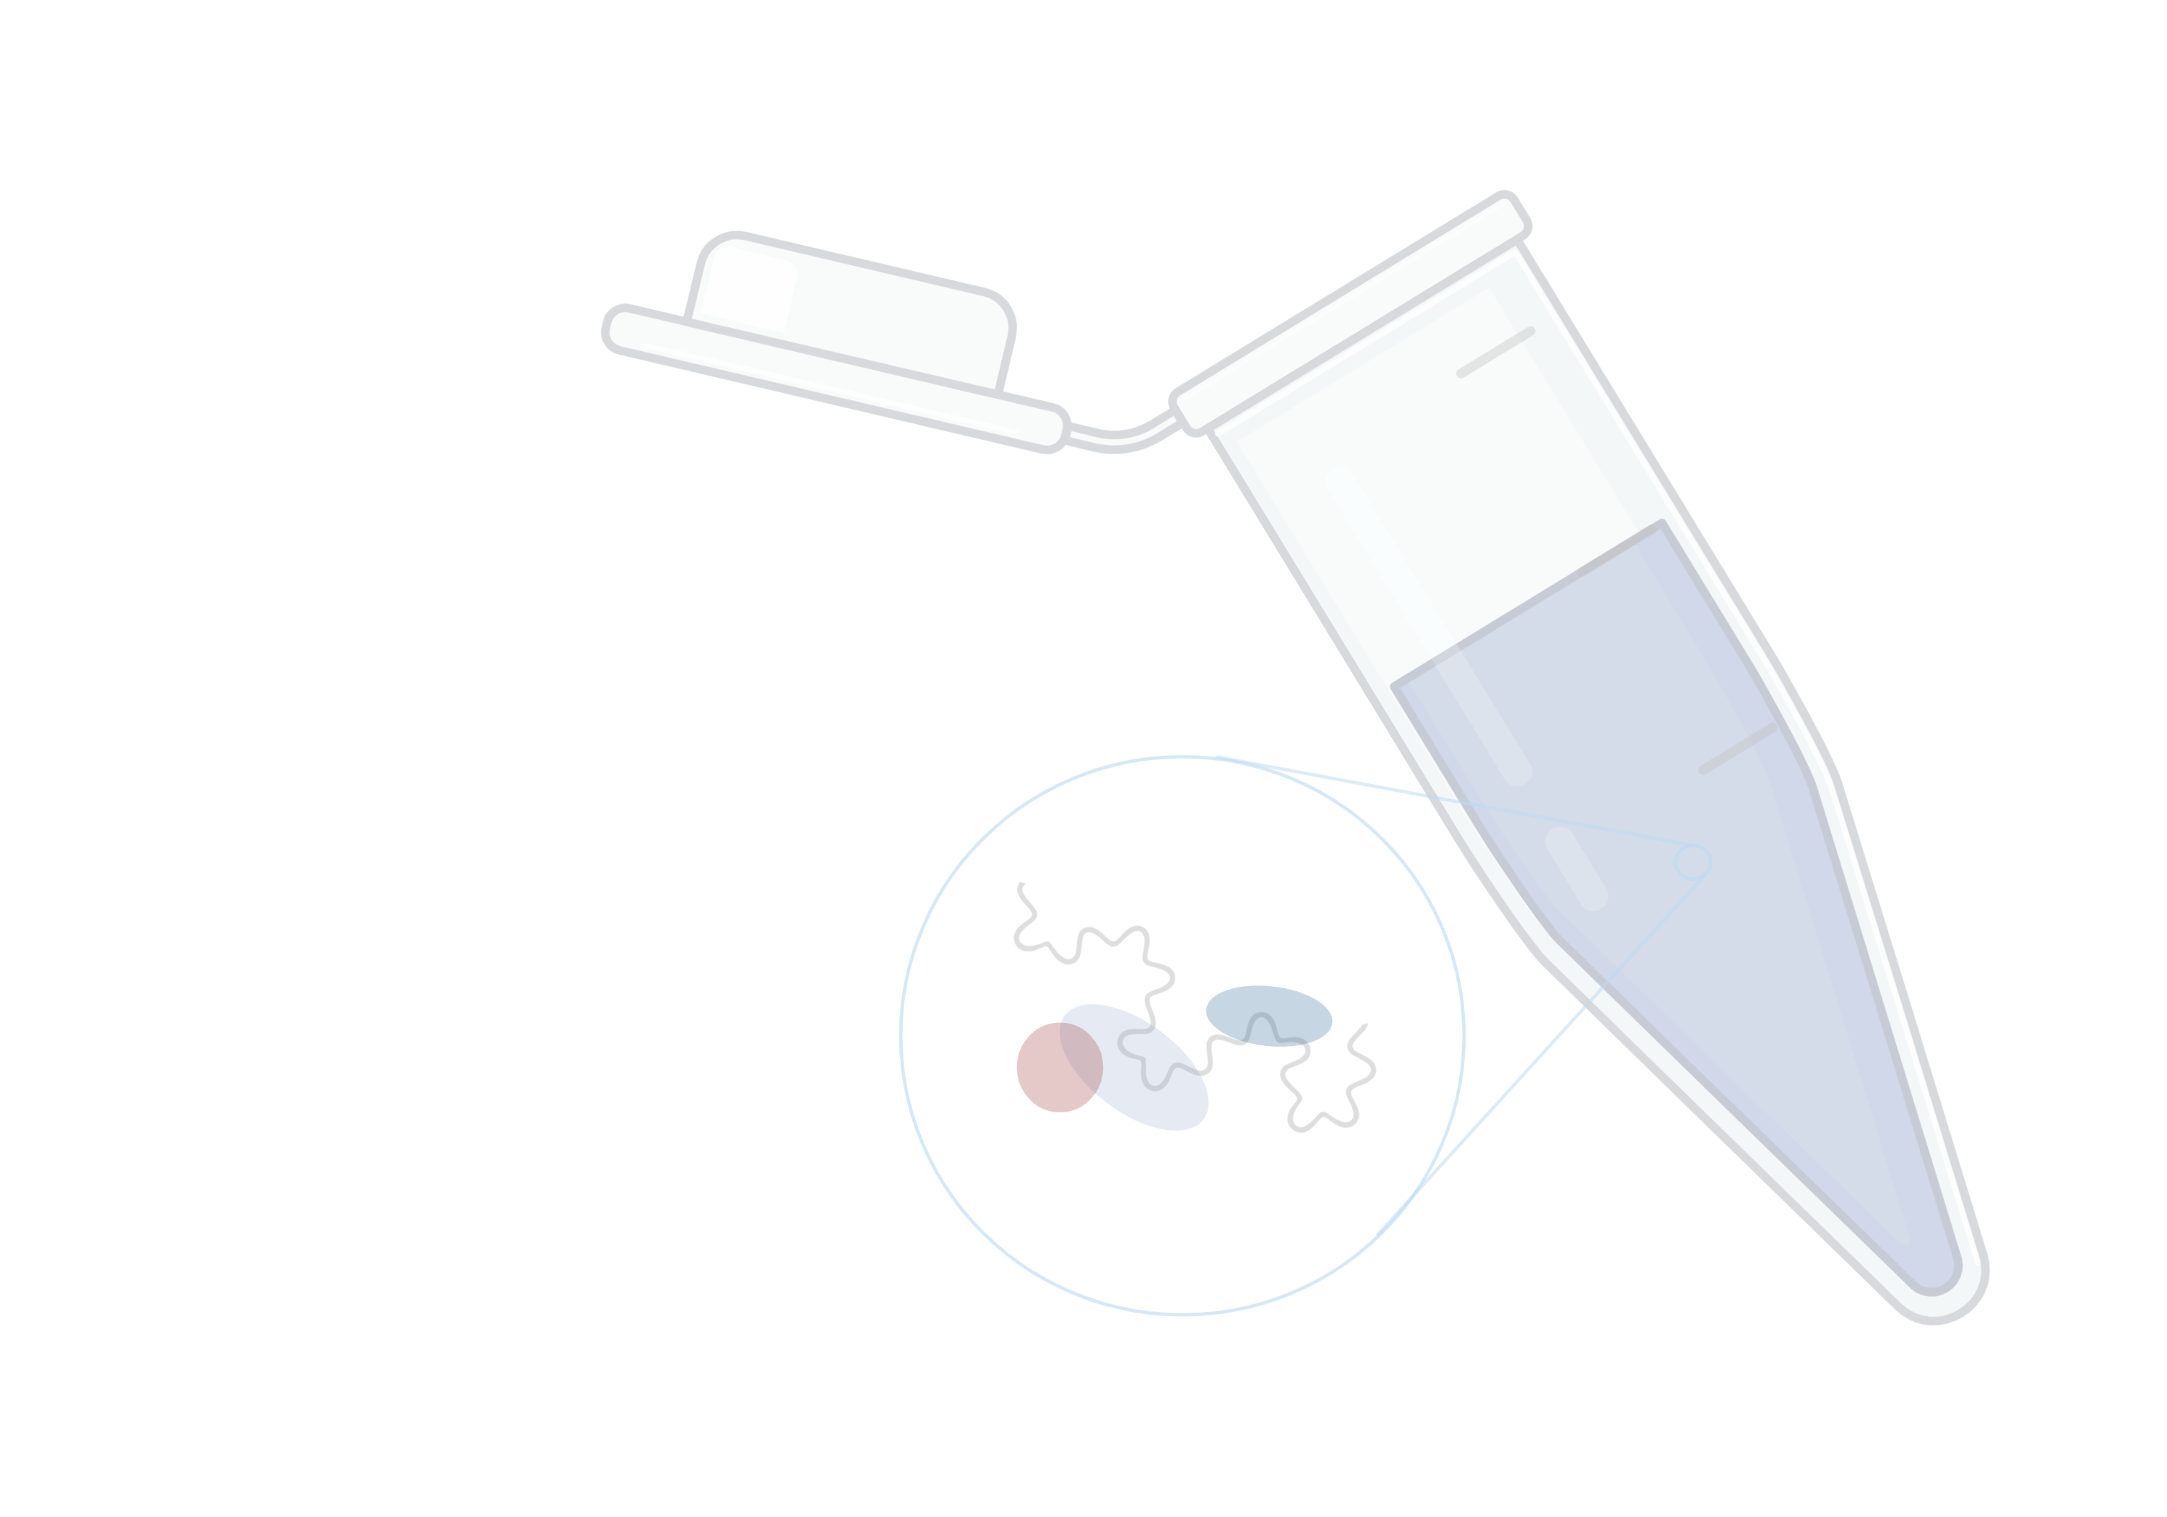
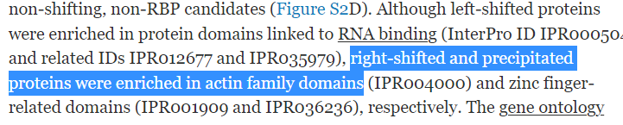
What do we want to find out?
Which proteins are RBPs & RNA dependent?
Regression analysis: Can we predict if a proteins is RNA dependent by looking at its other traits?
Second dataset: How do RBPs change according to cellular context?
Which interactions during the cell cycle are transient?
Can we find something similar? Do Actin associated RNA dependent proteins change during the cell cycle?

Slide 13
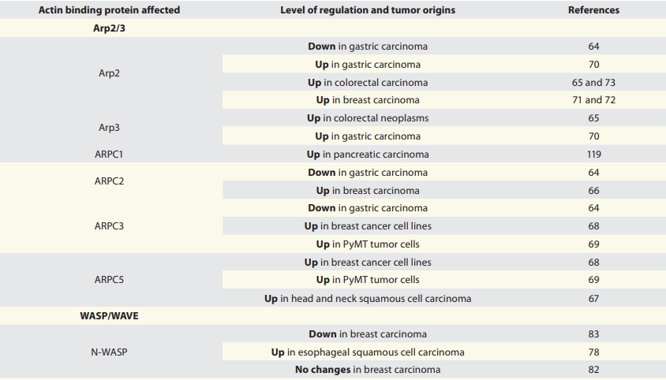
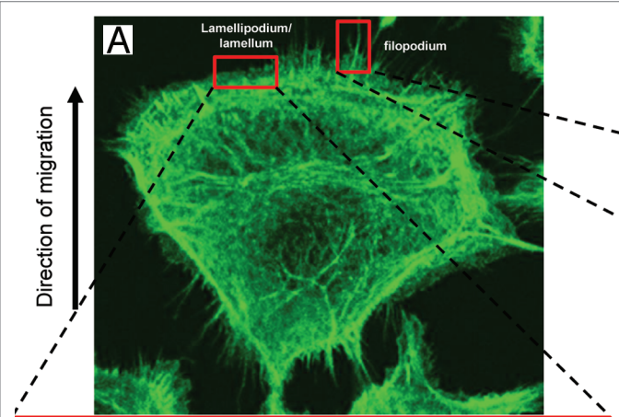
The role of Actin in cancer
Essential for cell motility
Cancer metastasis, cell division and proliferation
Invasivity of cancer cells & EMT
Potential of targeting cytoskeletal microfilaments in cancer therapy

Slide 14
Team organisation
at least one meeting per week
Where are we in the project?
Presenting what team members achieved
Open questions
Meeting after Tutorium
Assignment of tasks
Teams of two for more difficult/complex tasks

Slide 15
Data
& reduction
Literature review II
Data cleanup & reduction II
Data exploration
buffer Week
Data modellig
Data modelling II
Repeat with 2nd Dataset
&
Compare both Datasets
Wrap up data analysis
presenta-tion & report
finish presenta-tion & report
Milestones
Prepare Dataset for analysis
better understanding of biological question and project goal
1st week
2nd week
3rd week
4th week
5th week
6th week
7th week
8th week
9th week

Slide 16
Data cleanup & reduction
Literature review II
Data cleanup & reduction II
Data exploration
buffer Week
Data modellig
Data modelling II
Repeat with 2nd Dataset
&
Compare both Datasets
Wrapup data analysis
presentation & report
finish presentation & report
1st week
change class to numeric
identify and if needed delete NA’s
normalization protein quantity
deepen biological background and research of biological question
preformulate report introduction
Milestones
Prepare Dataset for analysis
better understanding of biological question
2nd week
3rd week
4th week
5th week
6th week
7th week
8th week
9th week

Slide 17
Data cleanup & reduction
Literature review II
Data cleanup & reduction II
Data exploration
buffer Week
Data modeling
Data modelling II
Repeat with 2nd Dataset
&
Compare both Datasets
Wrap-up data analysis
presenta-tion & report
finish present-ation & report
Milestones
Prepare Dataset for analysis
focus on essential information
1st week
2nd week
3rd week
4th week
5th week
6th week
7th week
8th week
9th week

Slide 18
Data cleanup & reduction
Literature review II
Data cleanup & reduction II
Data exploration
buffer Week
Data modellig
Data modelling II
Repeat with 2nd Dataset
&
Compare both Datasets
Wrapup data analysis
presentation & report
finish presentation & report
2nd week
identifying and removing batch effects
check reproducibility
dimension reduction
Milestones
Prepare Dataset for analysis
focus on essential information
1st week
3rd week
4th week
5th week
6th week
7th week
8th week
9th week

Slide 19
Data cleanup & reduction
Literature review II
Data cleanup & reduction II
Data exploration
buffer Week
Data modeling
Data modelling II
Repeat with 2nd Dataset
&
Compare both Datasets
Wrap-up data analysis
presenta-tion & report
finish presenta-tion & report
Milestones
Identification of possible RNA-dependent proteins
figuring out whether RNA-binding proteins are often associated with actin
1st week
2nd week
3rd week
4th week
5th week
6th week
7th week
8th week
9th week

Slide 20
3rd week
identifying maxima
plotting shifts between control and Rnase samples
choosing best protein database to compare to our data
Milestones
Identification of possible RNA-dependent proteins and similarities between such
figuring out whether RNA-binding proteins (RBPs) often are associated with actin
Data cleanup & reduction
Literature review II
Data cleanup & reduction II
Data exploration
buffer Week
Data modeling
Data modelling II
Repeat with 2nd Dataset
&
Compare both Datasets
Wrap-up data analysis
presentation & report
finish presentation & report
1st week
2nd week
4th week
5th week
6th week
7th week
8th week
9th week

Slide 21
Data cleanup & reduction
Literature review II
Data cleanup & reduction II
Data exploration
buffer Week
Data modeling
Data modelling II
Repeat with 2nd Dataset
&
Compare both Datasets
Wrap-up data analysis
presenta-tion & report
finish presenta-tion & report
Milestones
check relevance of shifts of maxima between control and Rnase samples
gain overview of possible similarities/properties of RNA-dependent proteins
1st week
2nd week
3rd week
4th week
5th week
6th week
7th week
8th week
9th week

Slide 22
4th week
statistical testing (e.g. t-test)
further comparison to protein databases
Milestones
check relevance of shifts of maxima between control and Rnase samples
gain overview of possible similarities/properties of RNA-dependent proteins
Data cleanup & reduction
Literature review II
Data cleanup & reduction II
Data exploration
buffer Week
Data modeling
Data modelling II
Repeat with 2nd Dataset
&
Compare both Datasets
Wrap-up data analysis
presentation & report
finish presenta-tion & report
1st week
2nd week
4th week
5th week
6th week
7th week
8th week
9th week

Slide 23
Data cleanup & reduction
Literature review II
Data cleanup & reduction II
Data exploration
buffer Week
Data modeling
Data modelling II
Repeat with 2nd Dataset
&
Compare both Datasets
Wrap-up data analysis
presenta-tion & report
finish presenta-tion & report
Milestones
figuring out whether there are trends between RBPs and if so, what they are
figuring out a method to predict RBPs
1st week
2nd week
3rd week
4th week
5th week
6th week
7th week
8th week
9th week

Slide 24
5th week
k-means
regression analysis
if time: repeat data analysis steps with 2nd data set
Milestones
figuring out whether there are trends between RBPs andif so, what they are
figuring out a method to predict RBPs
Data cleanup & reduction
Literature review II
Data cleanup & reduction II
Data exploration
buffer Week
Data modeling
Data modelling II
Repeat with 2nd Dataset
&
Compare both Datasets
Wrap-up data analysis
presentation & report
finish presentation & report
1st week
2nd week
4th week
5th week
6th week
7th week
8th week
9th week

Slide 25
Data cleanup & reduction
Literature review II
Data cleanup & reduction II
Data exploration
buffer Week
Data modeling
Data modelling II
Repeat with 2nd Dataset
&
Compare both Datasets
Wrap-up data analysis
presenta-tion & report
finish presenta-tion & report
Milestones
figuring out whether there are differences between (amount of) RBPs between both cell cycle phases
figuring out whether there are changes in actin associated RBPs between cell cycle phases
1st week
2nd week
3rd week
4th week
5th week
6th week
7th week
8th week
9th week

Slide 26
6th week
repeat data analysis steps with 2nd data set
compare findings 2nd dataset with protein data bases
compare results of both data sets
Milestones
figuring out whether there are differences between (amount of) RBPs between both cell cycle phases
figuring out whether there are changes in actin associated RBPs between cell cycle phases
Data cleanup & reduction
Literature review II
Data cleanup & reduction II
Data exploration
buffer Week
Data modeling
Data modelling II
Repeat with 2nd Dataset
&
Compare both Datasets
Wrap-up data analysis
presentation & report
finish presenta-tion & report
1st week
2nd week
4th week
5th week
6th week
7th week
8th week
9th week

Slide 27
Data cleanup & reduction
Literature review II
Data cleanup & reduction II
Data exploration
buffer Week
Data modeling
Data modelling II
Repeat with 2nd Dataset
&
Compare both Datasets
Wrap-up data analysis
presenta-tion & report
finish presenta-tion & report
1st week
2nd week
3rd week
4th week
5th week
6th week
7th week
8th week
9th week

Slide 28
7th week
finish data analysis and data set comparison
start writing project report
start preparation of final presentation
Data cleanup & reduction
Literature review II
Data cleanup & reduction II
Data exploration
buffer Week
Data modeling
Data modelling II
Repeat with 2nd Dataset
&
Compare both Datasets
Wrap-up data analysis
presentation & report
finish presentation & report
1st week
2nd week
4th week
5th week
6th week
7th week
8th week
9th week

Slide 29
Data cleanup & reduction
Literature review II
Data cleanup & reduction II
Data exploration
buffer Week
Data modeling
Data modelling II
Repeat with 2nd Dataset
&
Compare both Datasets
Wrap-up data analysis
presenta-tion & report
finish presenta-tion & report
1st week
2nd week
3rd week
4th week
5th week
6th week
7th week
8th week
9th week

Slide 30
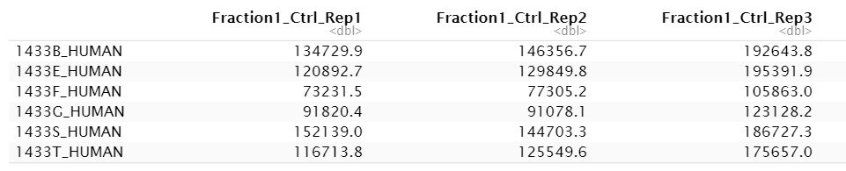
The data set
3 replicates with control sample
+ 3 replicates with RNase sample
separated into 25 fractions
→ 3*3*25 = 150 columns
rows = proteins (7086)
Amount of protein in fraction 1 of replicate 1 with control sample
EINHEIT???
Notes:
Data frame with 7086 rows and 150 columns
Rows = proteins
Col = Fraction 1-25 for a replicate of control or rnase sample
Values in Dalton?

Slide 31
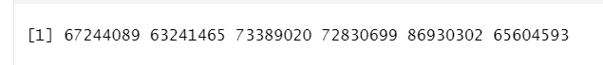
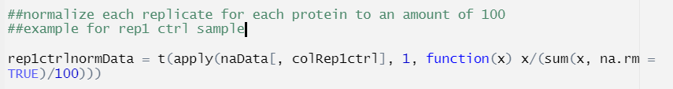
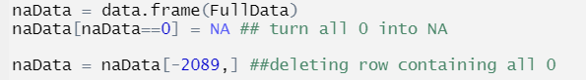
Statistical properties
every 6th measurement is part of one replicate
Different amounts of protein in replicates
many zeros

Slide 32
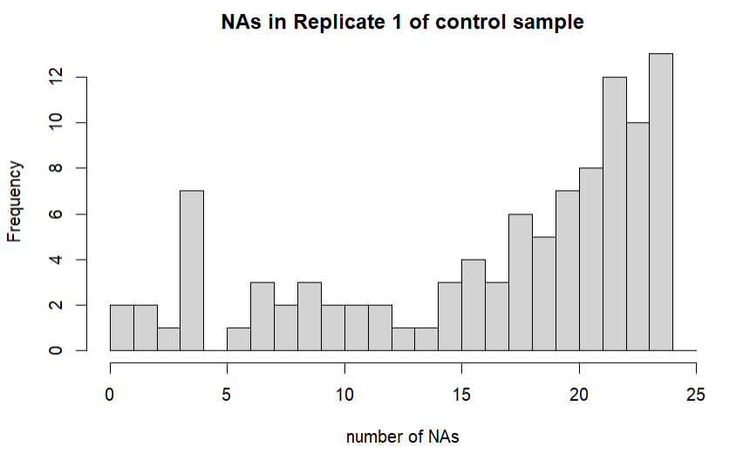
Statistical properties
Drop protein if it has more than 10 zeros in at least two replicates in control and/or Rnase sample

Slide 33
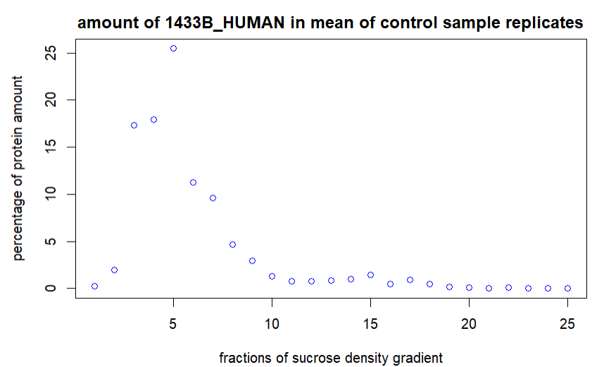
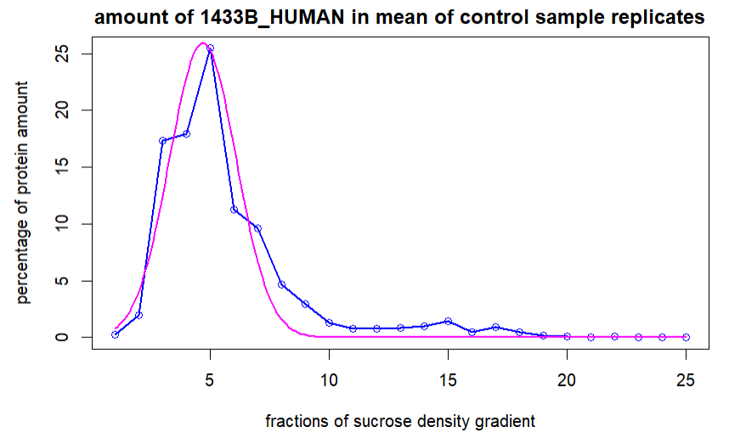
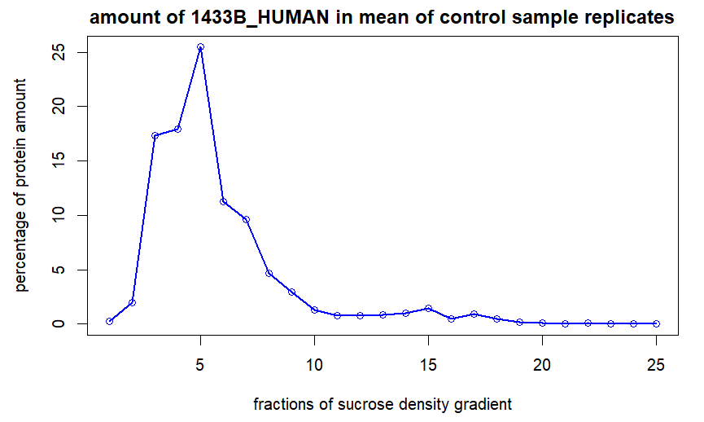
Normalization, Gaussian approximation
Notes:
- How we imagine it to look like in the end

Slide 34
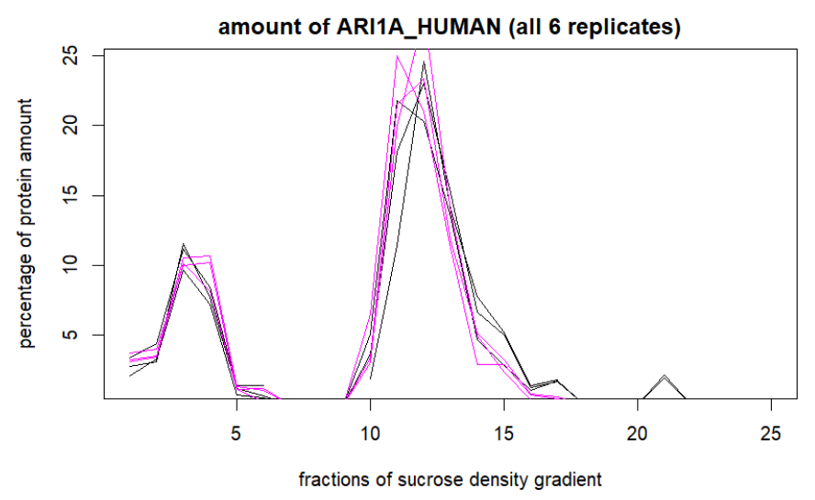
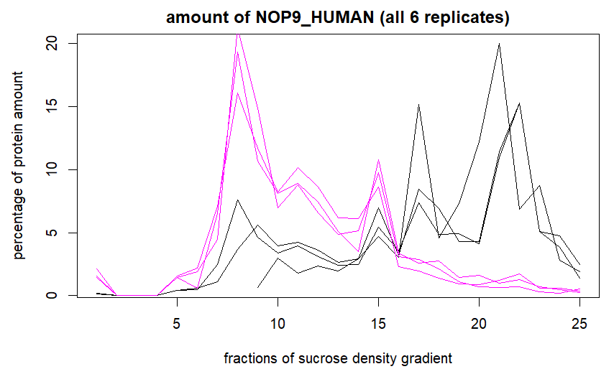
Shift between the fractions
Control = black
RNase = magenta

